Slide 1

Sentiment Analysis of Stocks via News Headlines
Vivekanand Education Society's Institute Of Technology
Address: Hashu Adwani Memorial Complex, Collector's Colony, Chembur, Mumbai, Maharashtra 400074
Department of Artificial Intelligence and Data Science
17, Swayam Gaikwad
24, Khyati Hegde
45, Anjali Parwani

Slide 2
Agenda
Introduction and Importance
Techniques
Architecture
Dataset
Web Scraping
Algorithms/Libraries Used
Output
Visualizations

Slide 3
Introduction And Importance
The rapid dissemination of information in today’s digital age, accurately assessing the emotional tone of market-related news is crucial for informed trading decisions.
This project uses sentiment analysis to understand how the market reacts to company-specific news, aiming to provide insights that may influence stock performance predictions.
Accurate sentiment prediction helps identify market trends, manage risk, and personalize investment strategies, improving the overall decision-making process in financial markets.

Slide 4
Techniques
Rule-Based Systems and Keyword Matching: Early approaches to sentiment analysis primarily relied on predefined rules and keyword matching to categorize news as positive, negative, or neutral.
Lexicon-Based Approach (VADER): In this project, we leveraged the VADER (Valence Aware Dictionary and Sentiment Reasoner) model, a lexicon-based sentiment analysis tool. VADER is specifically designed for short texts, such as news headlines, and is sensitive to the nuances of financial language.

Slide 5
Architecture
User Input
Data Preprocessing
Tokenization
Load Pretrained Model
Vectorization
Stopwords Removal
Sentiment Classification
Prediction(VADER)
Sentiment Labeling(Output)

Slide 6
Dataset
News Articles: The dataset consists of financial news articles collected from various sources, providing insights into market trends and company performance.(HTML Files)
Categories: The news articles are categorized into topics such as stock performance, earnings, market predictions, and macroeconomic news.
Labels: Each article is labeled based on sentiment (positive, negative, neutral) for classification purposes.
Notes:
Load Dataset: Read CSV file containing news data.
Data Preprocessing: Remove HTML tags, URLs, emojis, and punctuation; convert text to lowercase.
Handle Imbalance: Group rare categories into 'Other' and compute class weights.
Tokenization: Split content into tokens using word and sentence tokenization.
Stopword Removal: Filter out common stopwords from the content.
Abbreviation Replacement: Replace abbreviations with their full forms.
Train-Test Split: Divide dataset into training and testing sets.
Model Creation: Create a pipeline with Count Vectorizer and Multinomial Naive Bayes.
Model Training: Fit the model using training data.
Model Evaluation: Predict categories on test data and evaluate accuracy and classification report.
Hyperparameter Tuning: Use Randomized Search CV to find the best hyperparameters.
Deployment: Create a Gradio interface for user interaction and predictions.

Slide 7
Web Scraping
Finviz Scraping :
Source: Financial data was scraped from Finviz, a stock screener website that provides real-time market analysis, stock charts, and financial news.
Use: The data gathered includes stock-related news, which is utilized for further sentiment analysis in predicting market movement.
Notes:
Load Dataset: Read CSV file containing news data.
Data Preprocessing: Remove HTML tags, URLs, emojis, and punctuation; convert text to lowercase.
Handle Imbalance: Group rare categories into 'Other' and compute class weights.
Tokenization: Split content into tokens using word and sentence tokenization.
Stopword Removal: Filter out common stopwords from the content.
Abbreviation Replacement: Replace abbreviations with their full forms.
Train-Test Split: Divide dataset into training and testing sets.
Model Creation: Create a pipeline with Count Vectorizer and Multinomial Naive Bayes.
Model Training: Fit the model using training data.
Model Evaluation: Predict categories on test data and evaluate accuracy and classification report.
Hyperparameter Tuning: Use Randomized Search CV to find the best hyperparameters.
Deployment: Create a Gradio interface for user interaction and predictions.

Slide 8
Web Scraping
Tesla Web Scraping
Source: Specific web scraping was done on Tesla-related news from financial news sites and company blogs to collect sentiment around Tesla’s stock performance.
Use: This data helps in understanding how news surrounding Tesla impacts its stock price, providing a case study for the model’s prediction capability.
Notes:
Load Dataset: Read CSV file containing news data.
Data Preprocessing: Remove HTML tags, URLs, emojis, and punctuation; convert text to lowercase.
Handle Imbalance: Group rare categories into 'Other' and compute class weights.
Tokenization: Split content into tokens using word and sentence tokenization.
Stopword Removal: Filter out common stopwords from the content.
Abbreviation Replacement: Replace abbreviations with their full forms.
Train-Test Split: Divide dataset into training and testing sets.
Model Creation: Create a pipeline with Count Vectorizer and Multinomial Naive Bayes.
Model Training: Fit the model using training data.
Model Evaluation: Predict categories on test data and evaluate accuracy and classification report.
Hyperparameter Tuning: Use Randomized Search CV to find the best hyperparameters.
Deployment: Create a Gradio interface for user interaction and predictions.

Slide 9
Algorithms/Libraries Used
BeautifulSoup: For web scraping and parsing HTML content.
Count Vectorization: Transforms text into numerical representation for document-term matrix.
Multinomial Naive Bayes: A probabilistic classifier used for sentiment classification.
VADER Sentiment Analysis: Pretrained sentiment analysis model tailored for financial headlines.
Randomized Search CV: For hyperparameter tuning of models.
Matplotlib and Seaborn: For data visualization, particularly sentiment scores over time.
Notes:
Sure! Here are the explanations with NLP terminology:
1. Count Vectorization
Transforms text into a numerical representation using n-grams to create a document-term matrix based on word counts.
2. Multinomial Naive Bayes
A generative probabilistic classifier that applies Bayes' theorem, assuming feature independence, suitable for multi-class text classification based on term frequencies.
3. Randomized Search CV
An optimization technique that explores hyperparameter combinations in the context of model training, particularly useful for tuning classifiers in text classification tasks

Slide 10
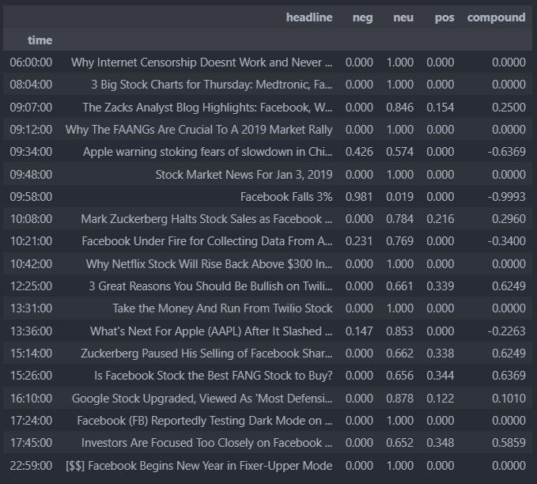
Output

Slide 11
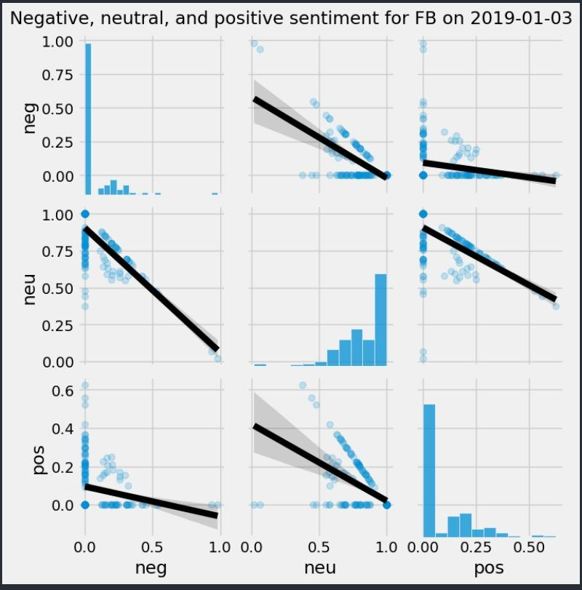
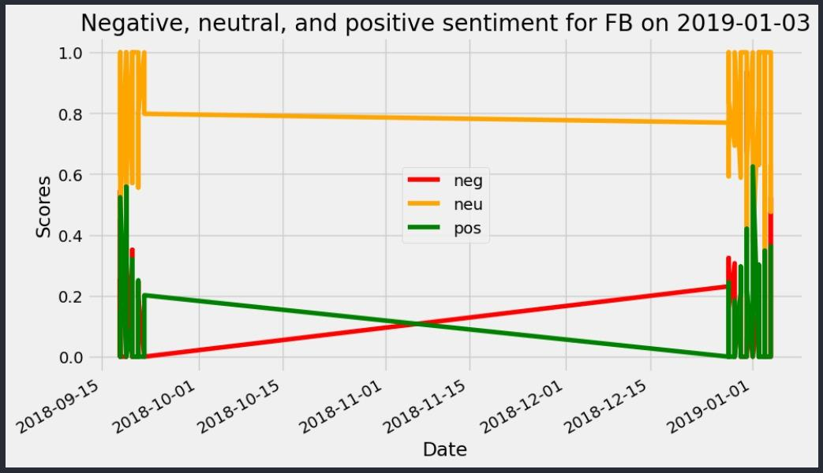
Visualizations

Slide 12
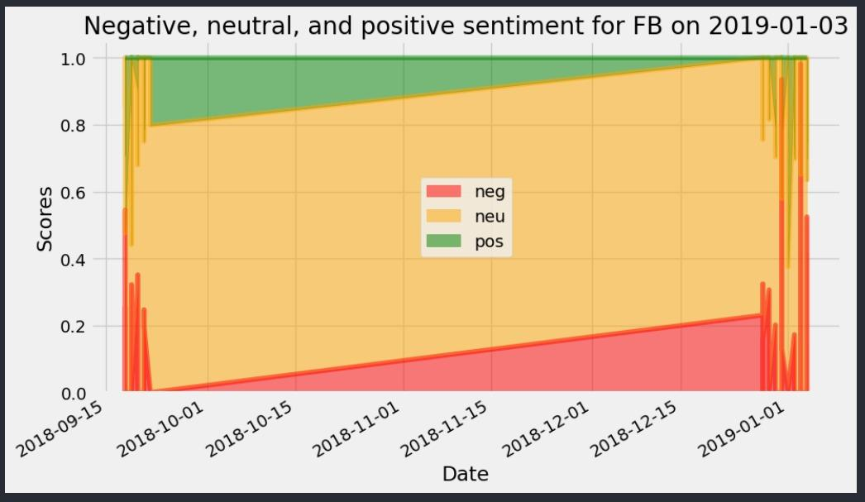
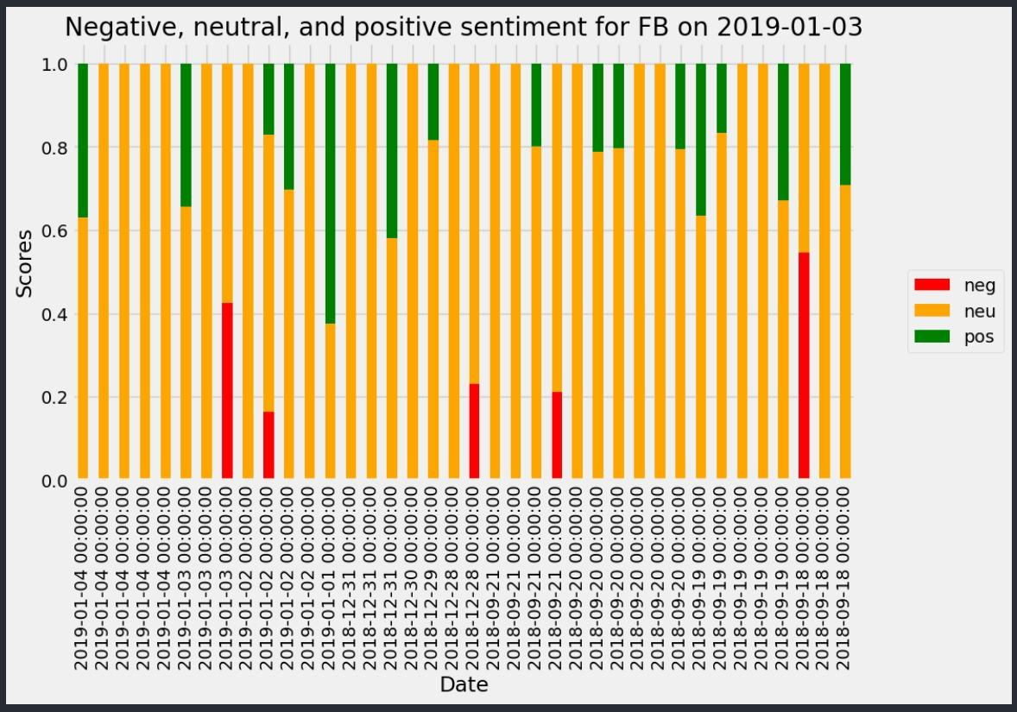
Visualizations

